Slide 1
2015.06.15(Mon)
Term Project
DC Motor speed control with compensator
Class : | Physical System Modeling and Control
Instructor : | Prof. Park, Kyi Hwan
Members : | 20151049 최윤정 20151160 Abdullah Tahir

Slide 2
Contents
1
Motor Analysis
2
Lead-Lag Compensator
3
Differential Amplifier
4
Simulink

Slide 3
Overview
Block diagram
Block diagram of Whole system
V ref
+
Controller
Power
Amp
Plant
Velocity
-
Tachometer
Differential Amplifier with Gain=1
Lead-Lag Compensator
LM675 Operational Amplifier can provide 3A current and ±30V so we will use this for supplying power to Plant
Armature Controlled Brushed DC Motor

Slide 4
1
Motor Analysis
(Time Domain and Frequency Domain)

Slide 5
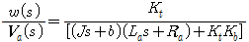
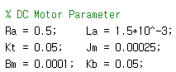
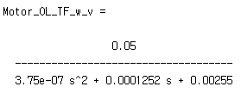
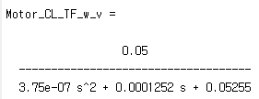
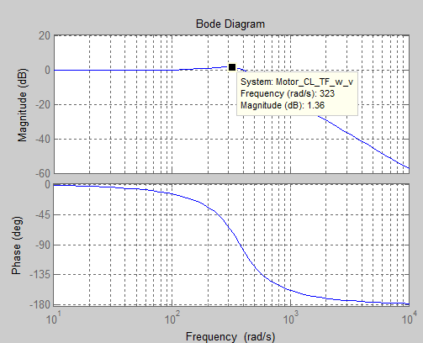
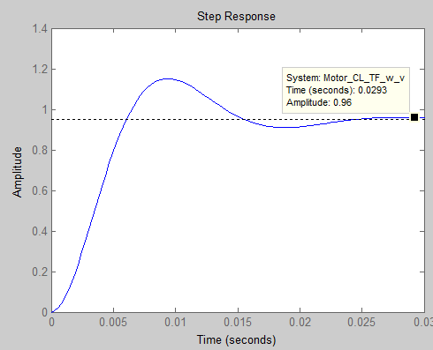
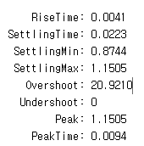
1. Motor Analysis
ω/v Closed Loop Transfer Function with Unity Feedback
Notes:
Closed

Slide 6
2
Lead-Lag Compensator

Slide 7
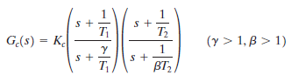
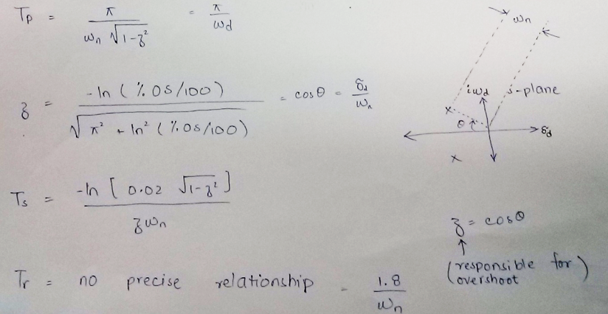
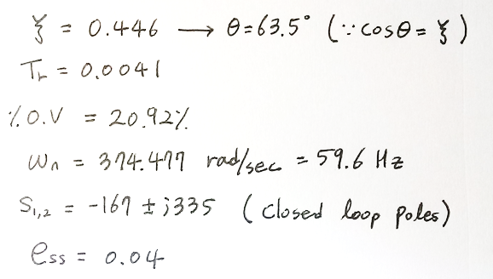
2. Lead-Lag Compensator
Current Motor spec.
GainMargin: Inf (at Inf Hz)
PhaseMargin: 82.7* (at 63.1 Hz)
Bandwidth: 497.7647

Slide 8
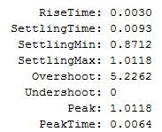
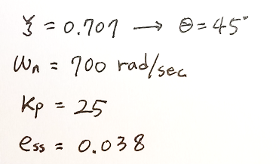
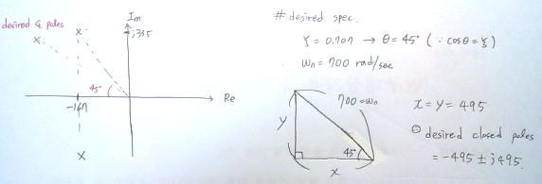
2. Lead-Lag Compensator
Desired Spec.
Compensator Design
Current Pole Location
Desired Pole Location

Slide 9
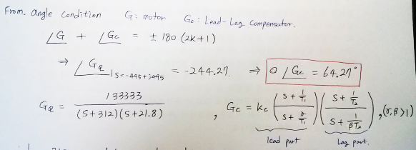
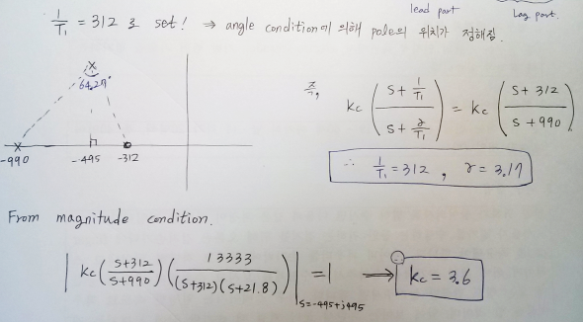
2. Lead-Lag Compensator
Angle to be provided by Lead Compensator
Find the values of Lead part

Slide 10
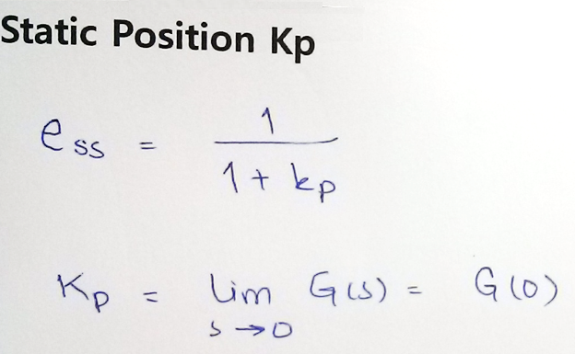
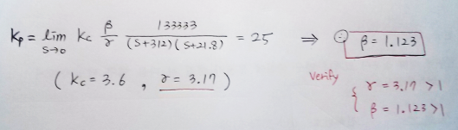
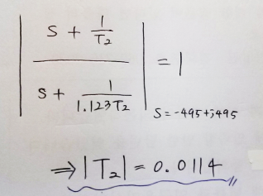
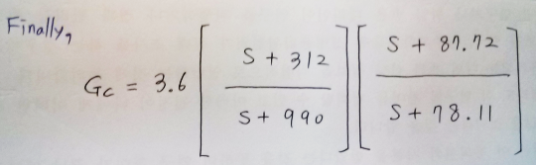
2. Lead-Lag Compensator
Find the values of Lag Part
&
Lead – Lag Compensator according to required specifications

Slide 11
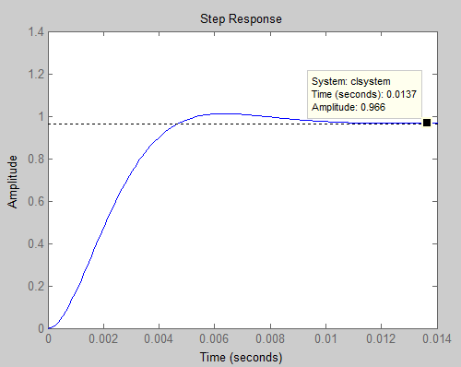
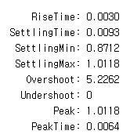
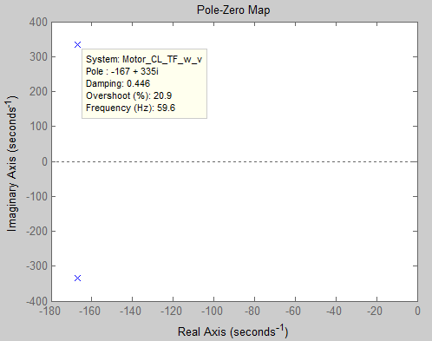
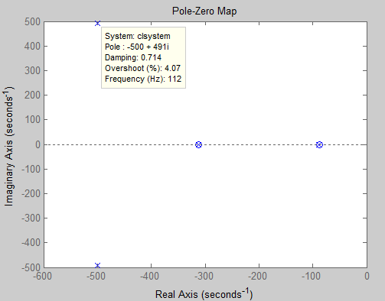
2. Lead-Lag Compensator
Comparison in Time Domain [Unit Step Input]
Uncompensated System
Compensated System
ess: 0.04
ess: 0.038
Dominant Poles at Desired Location
Poles Not at Desired Location

Slide 12
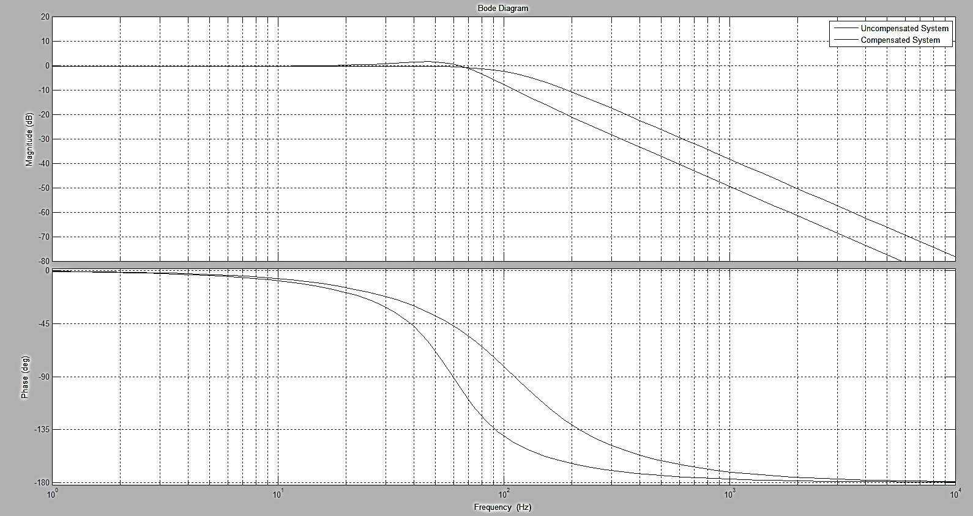
2. Lead-Lag Compensator
Comparison in Frequency Domain [Bode Plot]
Uncompensated System
Gain Margin = Inf (at Inf Hz)
Phase Margin = 82.7 (at 63.1Hz)
Band Width = 77 Hz
Compensated System
Gain Margin = Inf (at Inf Hz)
Phase Margin = Inf
Band Width = 107 Hz

Slide 13
Simulink Model

Slide 14
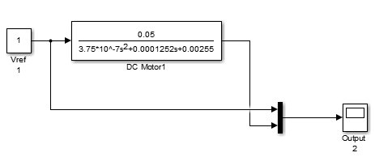
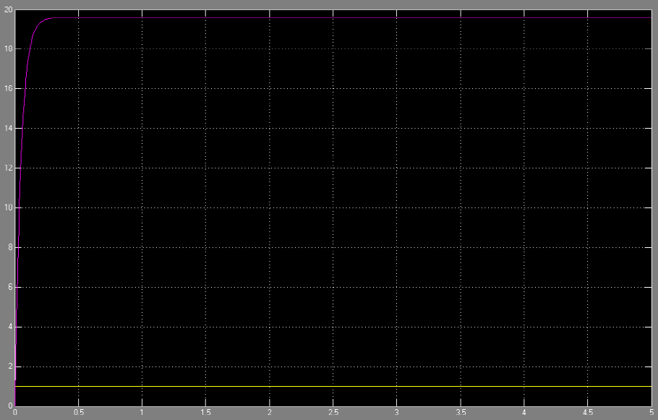
4. Simulink Model
Motor – Open loop system
Simulink Model
Yellow: Input
Pink: Output

Slide 15
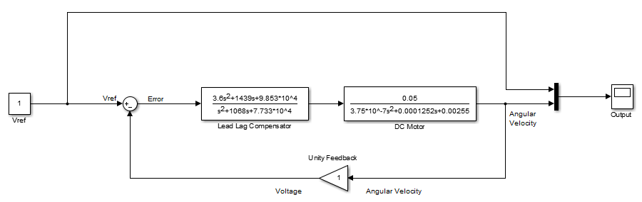
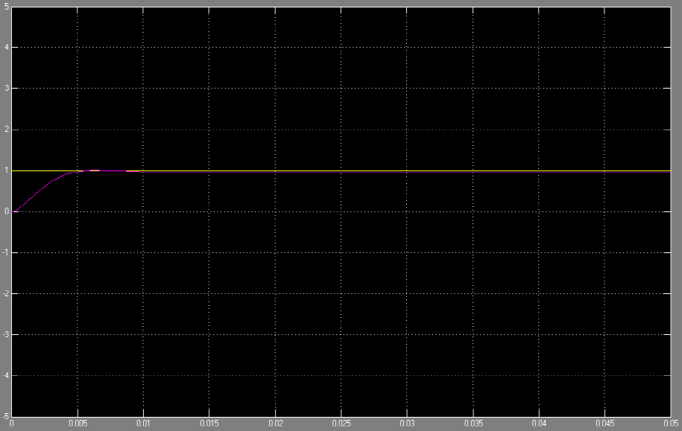
4. Simulink Model
Simulink
Yellow: Input
Pink: Output

Slide 16
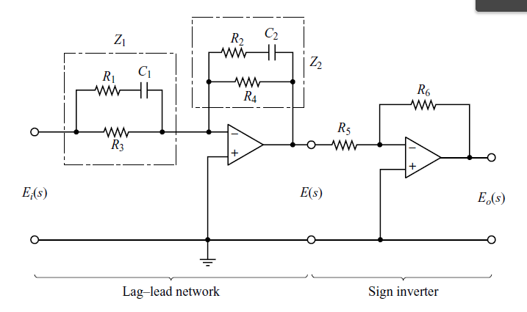
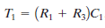
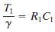
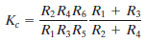
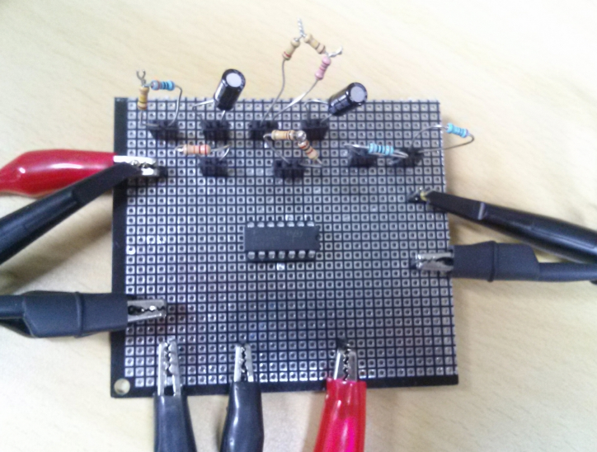
2-2. Lead-Lag Compensator
Circuit
Calculate the value of parameters
C1 = C2 =0.1uF
R1 = 10101
R2 = 113999
R3 = 21950
R4 = 14026
R5 = 1000
R6 = 1806

Slide 17
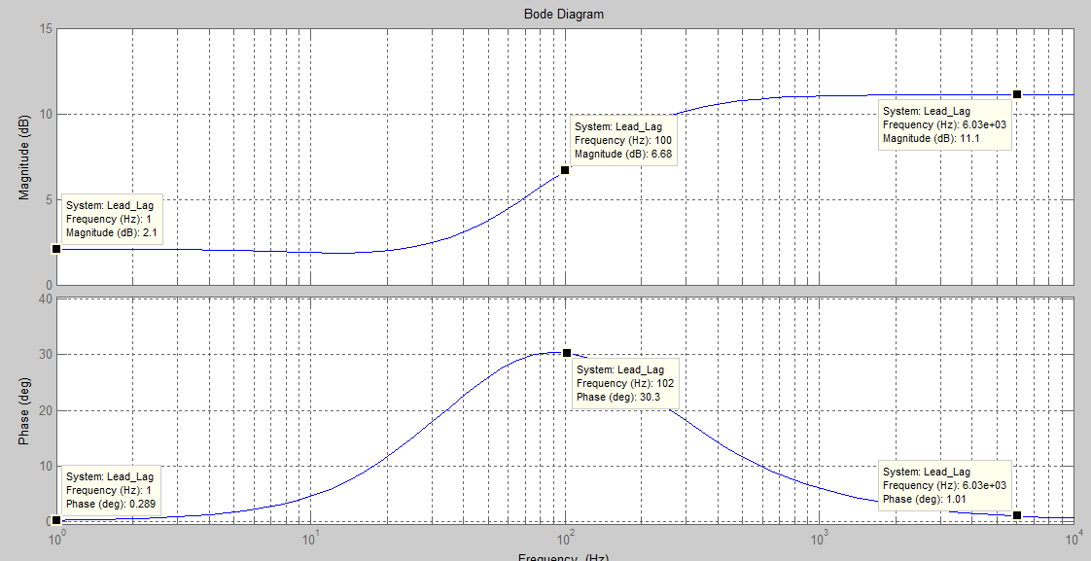
2-2. Lead-Lag Compensator
Experiment
Bode plot of Lead-Lag Compensator

Slide 18
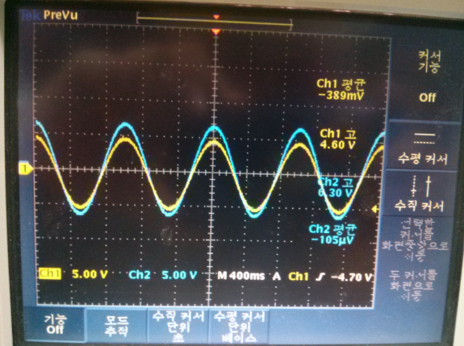
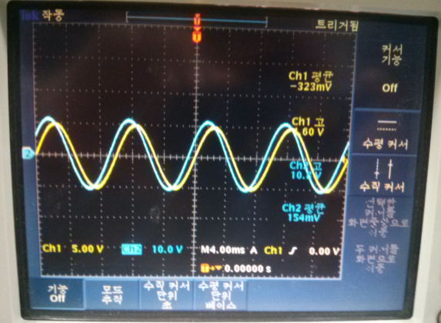
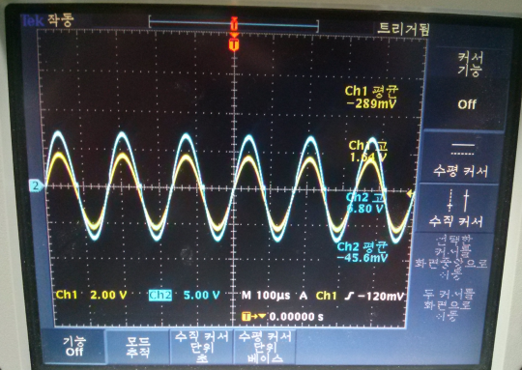
2-2. Lead-Lag compensator
Experiment
Result
Input : 4.6 V
Output : 6.3 V
Freq. : 1Hz
Input : 4.6 V
Output : 10.8 V
Freq. : 100Hz
Input : 1.64 V
Output : 6.8 V
Freq. : 6KHz

Slide 19
Thank You

